Slide 1
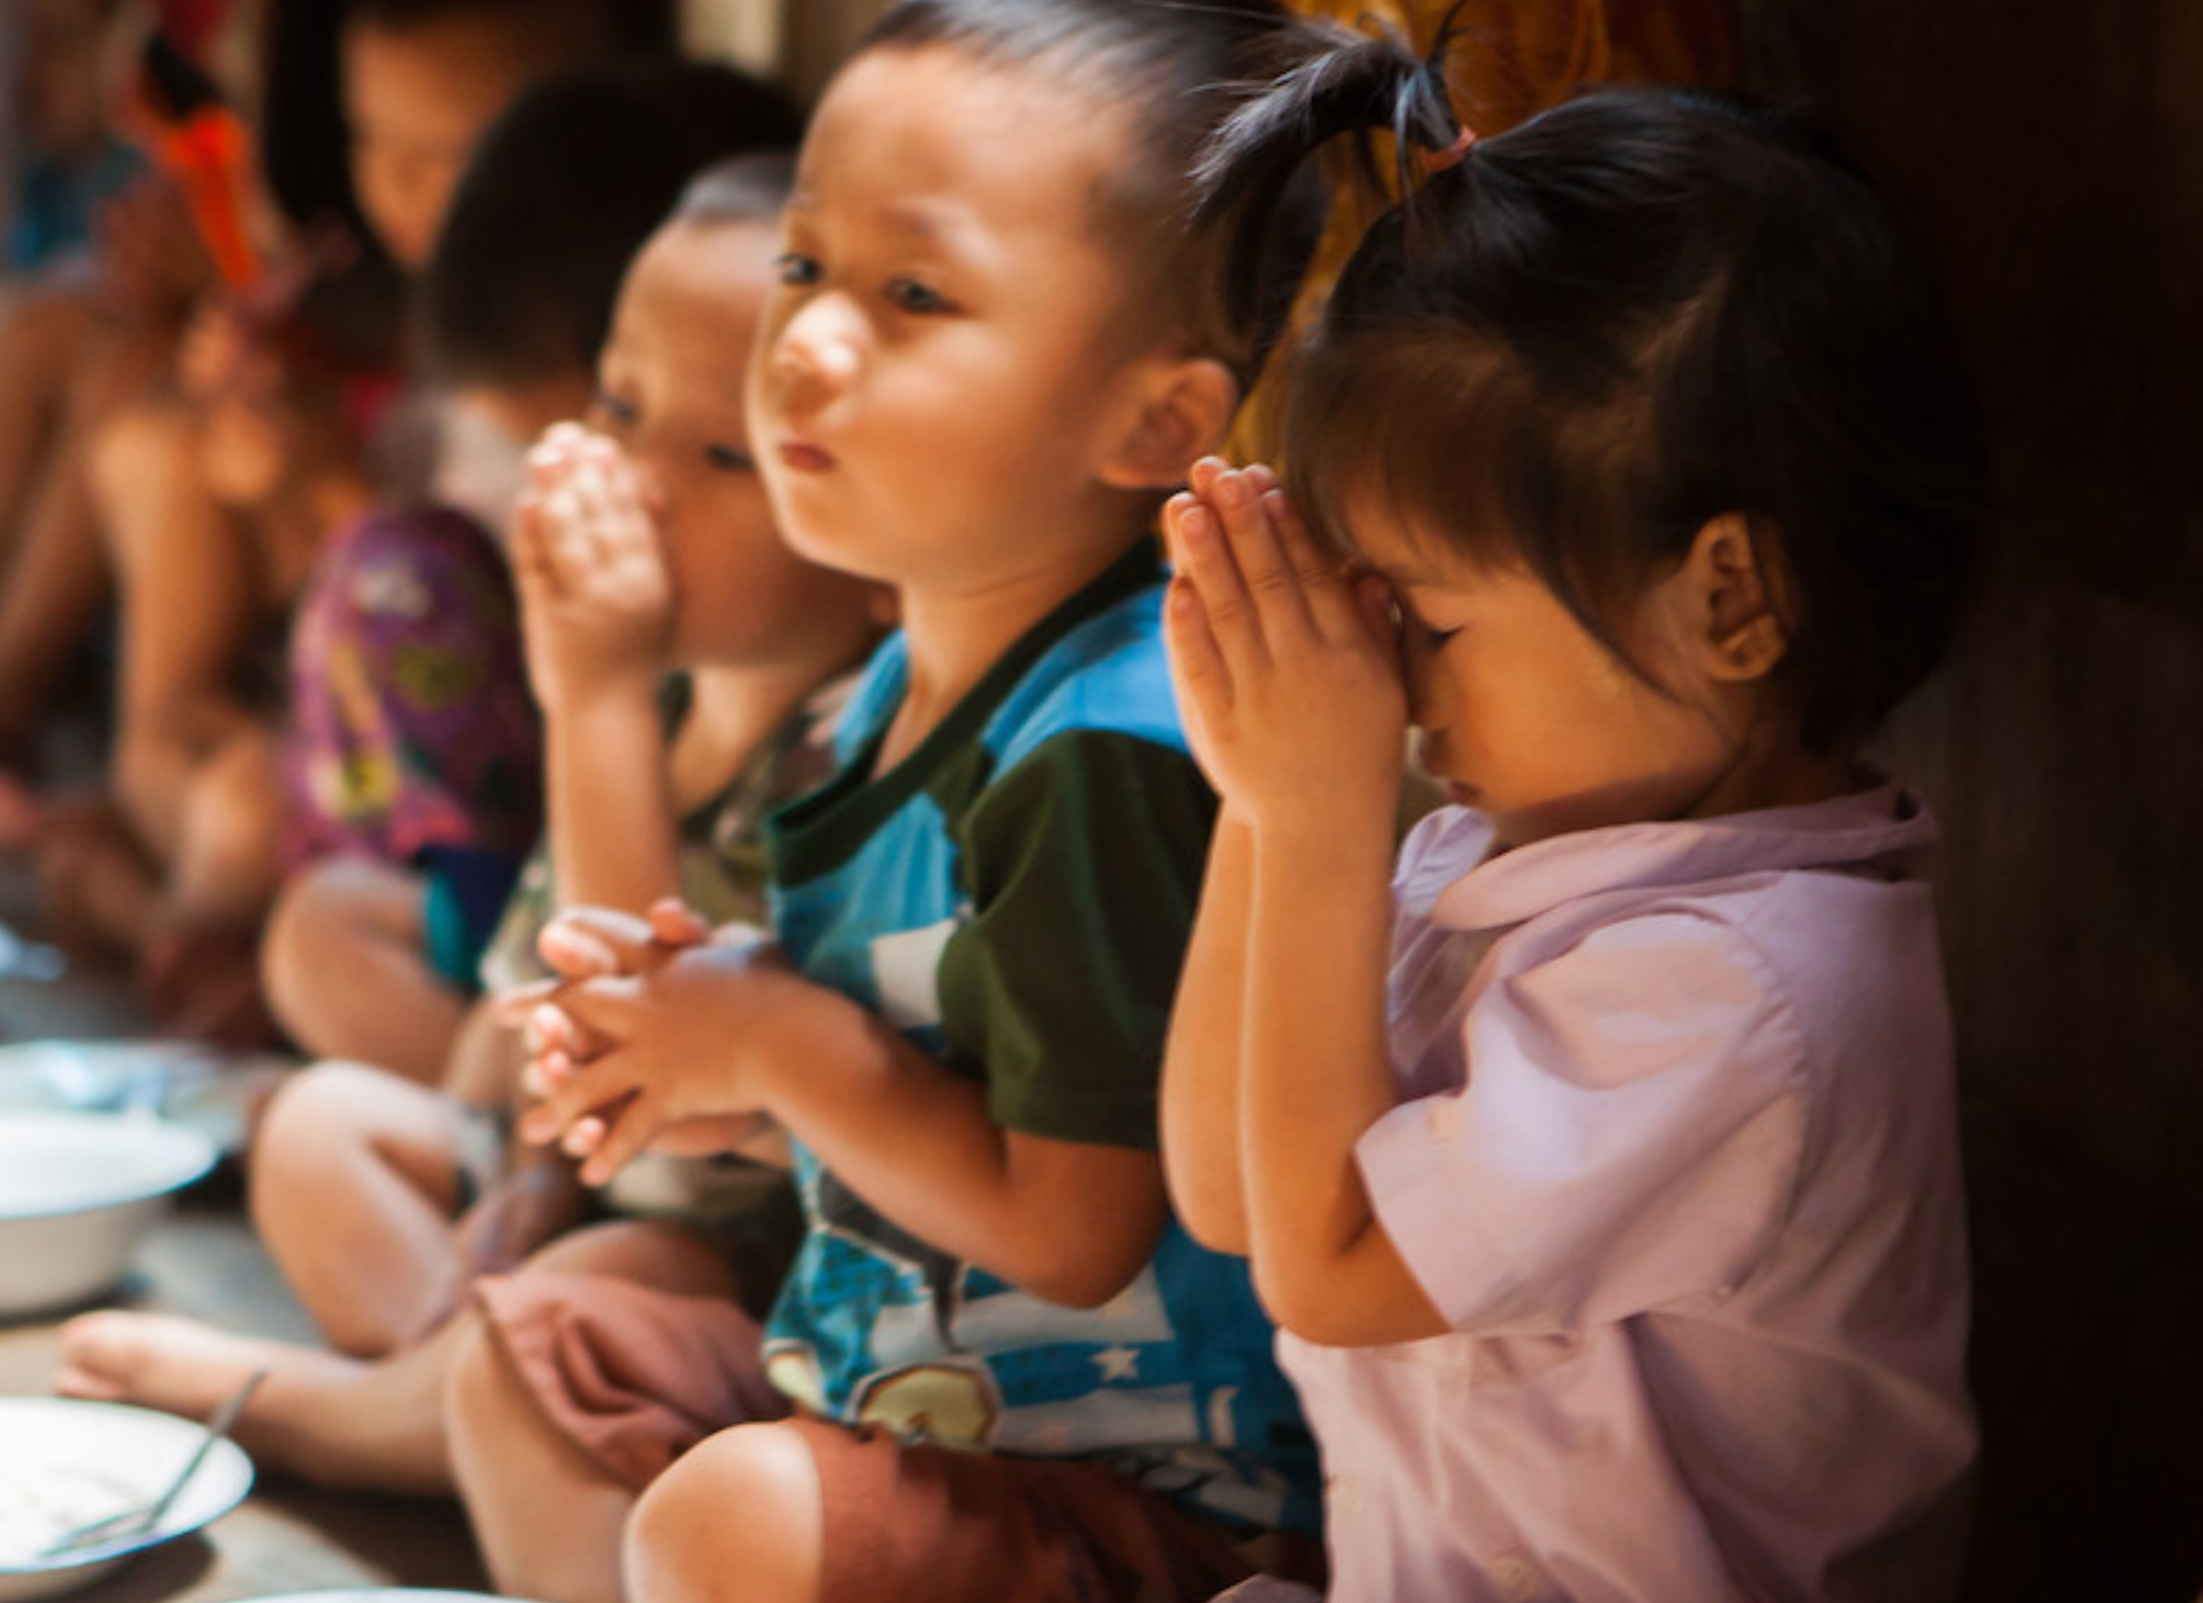


Humanitarian programs are
life changing for people displaced by conflict and disaster.
These programs aid humans
in need to rebuild their lives.
The impact of the decline in government aid funding is catastrophic for displaced people around the world. People who need our
help the most.
Together we can put the human back into
humanitarian aid.
Act for peace today.
HUMANITARIAN AID APPEAL
actforpeace.org.au/aid-hope
for humanKind
Thailand. Ben Littlejohn/Act for Peace
Notes:
[READ SLIDE]

