Slide 1
HUMANITARIAN AID APPEAL
for humanKind
Notes:
Act for Peace is the international humanitarian agency of the National Council of Churches in Australia.
They are the charity that runs the annual Christmas Bowl which we celebrate in December.
They have just launched an urgent “Humanitarian Aid Appeal”, which I would like to share with you today.
Governments around the world are slashing humanitarian aid budgets and cancelling refugee resettlement intake programs – decisions that may look good on a government balance sheet but have a devastating human cost.
The most recent, which you may have seen in the news, is the abrupt dismantling of USAID, which provided more than US$1 billion of humanitarian aid across the world.

Slide 2
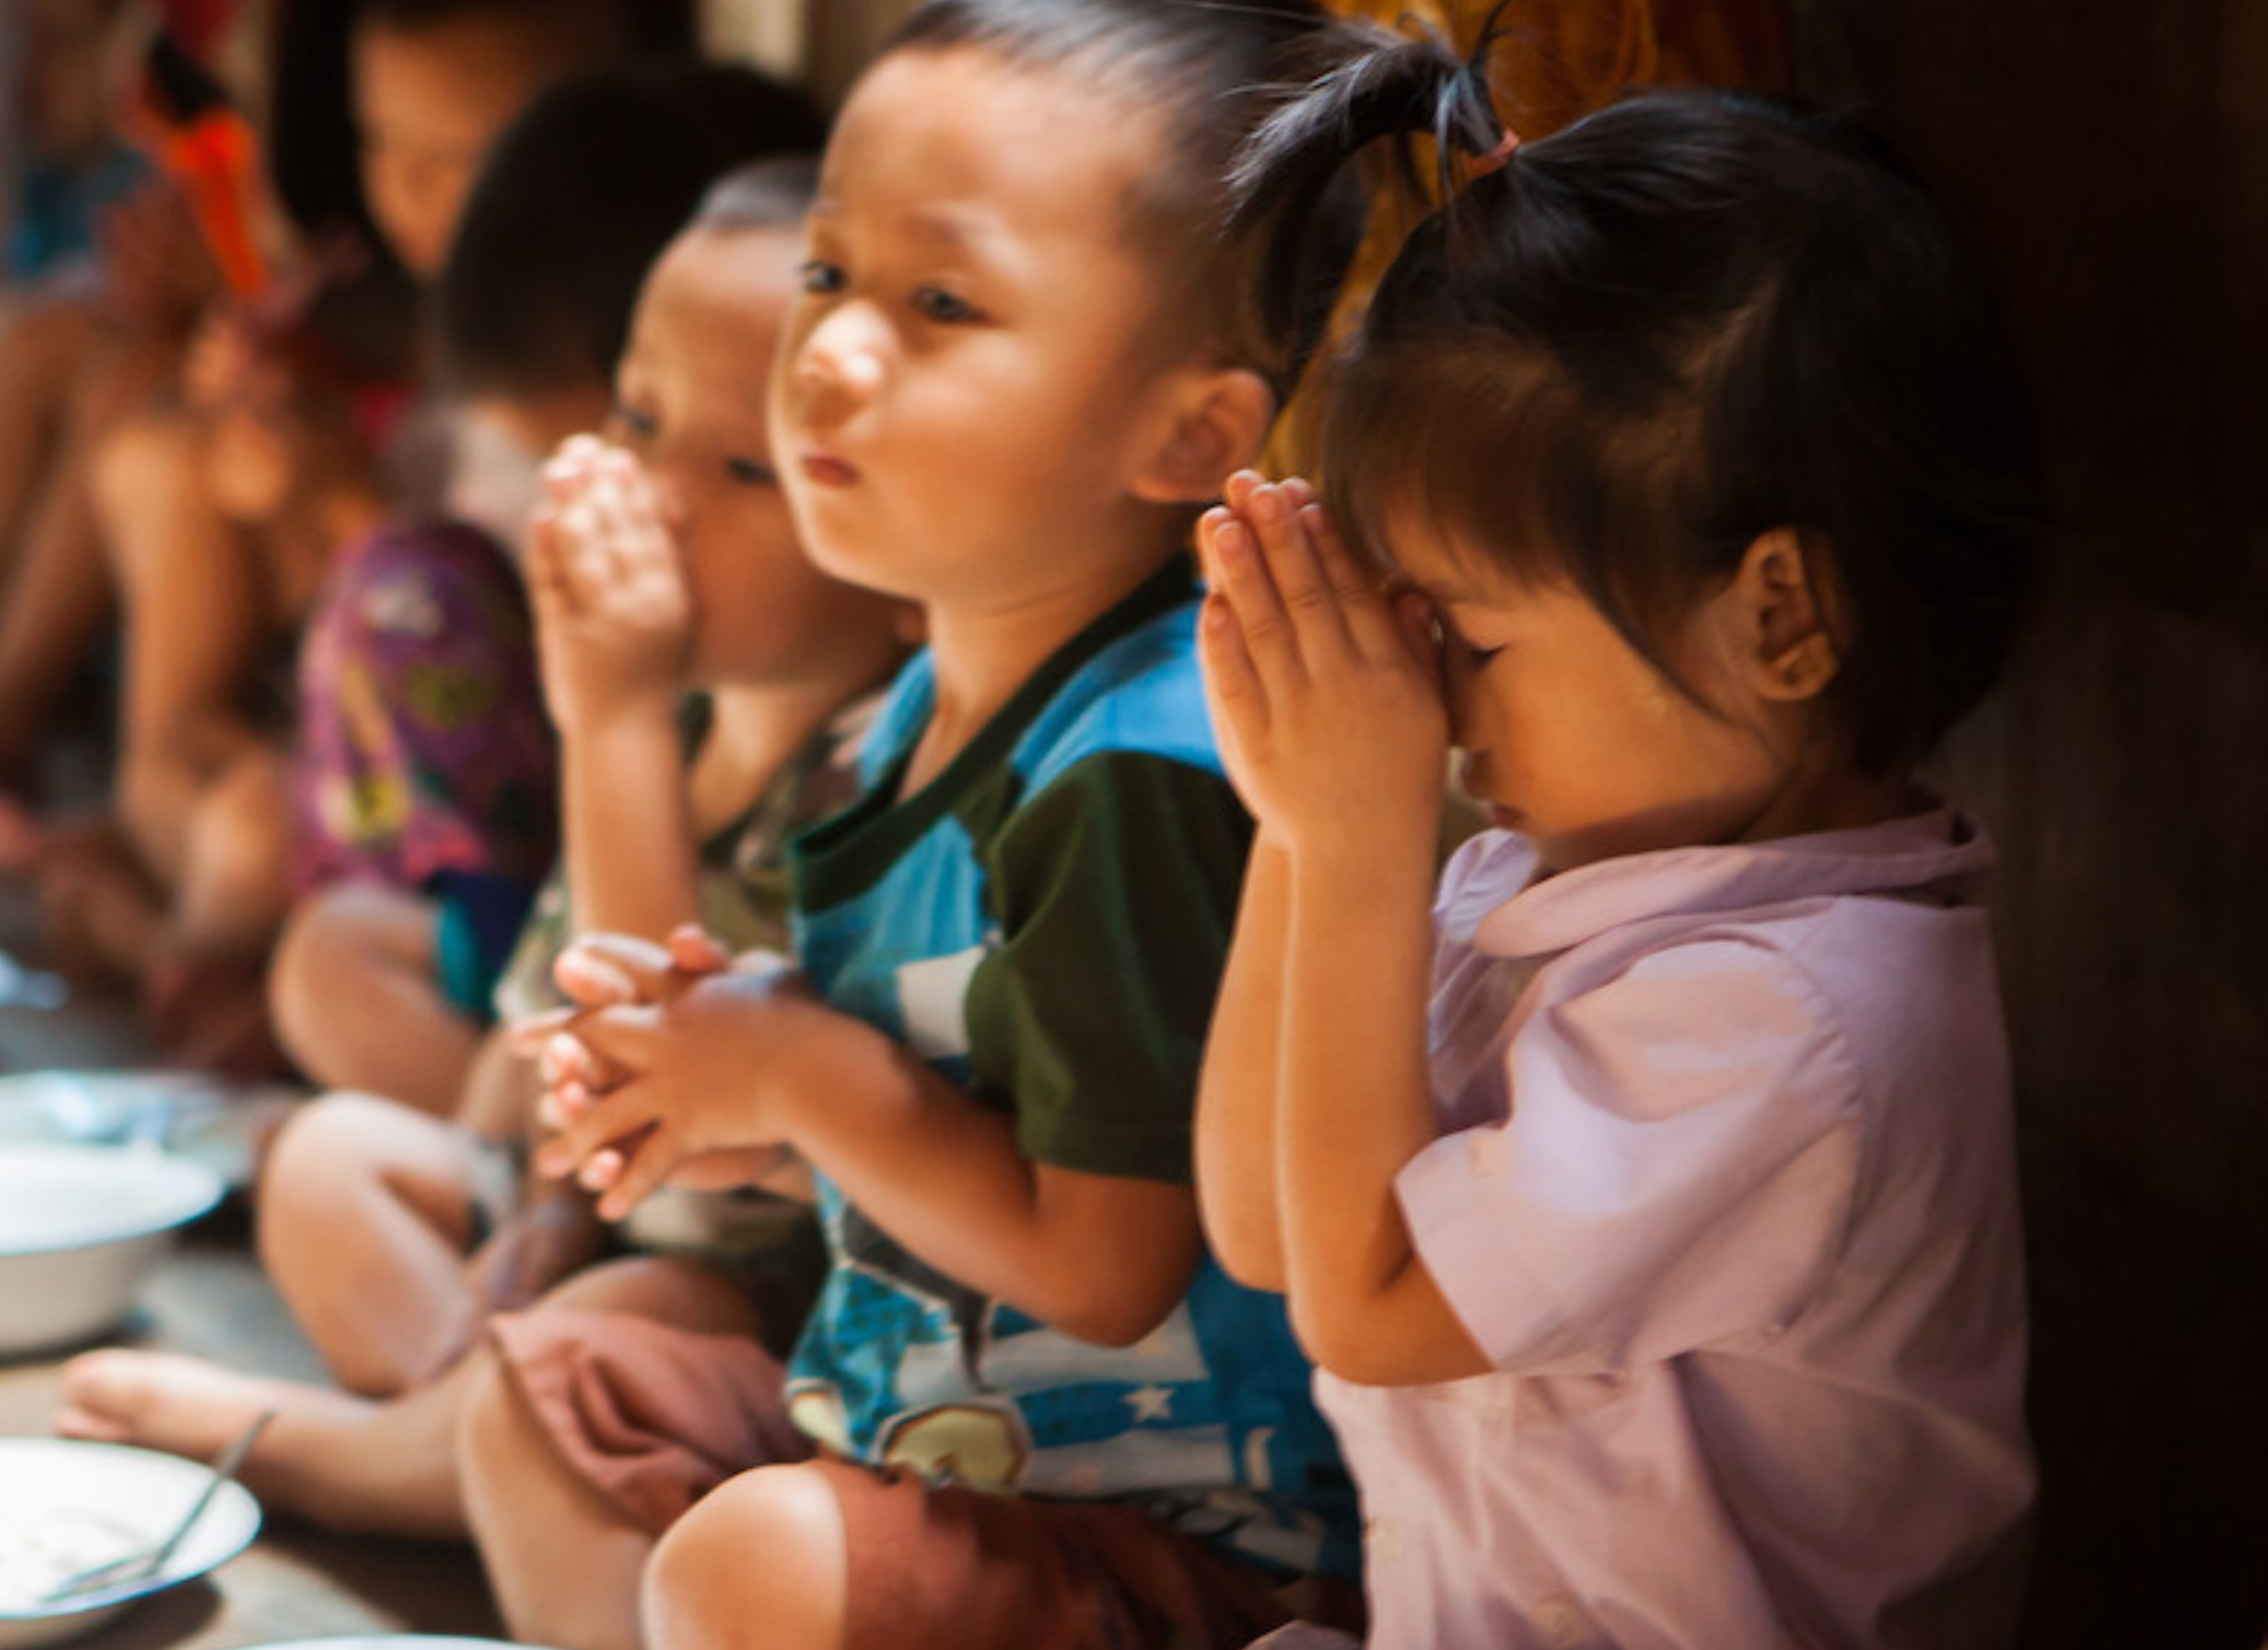
Humanitarian programs are life changing for people displaced by conflict and disaster.
These programs aid humans in need to rebuild their lives.
The impact of the decline in government aid funding is catastrophic for displaced people around the world. People who need our help the most.
Together we can put the human back into humanitarian aid.
Act for peace today.
HUMANITARIAN AID
for humanKind
Thailand. Ben Littlejohn/Act for Peace
Notes:
[READ SLIDE]

Slide 3
THE HUMAN IMPACT
Cuts in humanitarian aid are having a seismic impact on at-risk communities – and the human cost is devastating.
Many of Act for Peace’s local partners are suddenly without the funding they need to deliver life-saving humanitarian programs. As a direct result, they can no longer provide essential services to people who are already in crisis.
If these aid cuts continue, it’s not just food, healthcare and education that will be lost. Decades of progress towards equality, justice, and stability will be undone.
for humanKind
Notes:
[READ SLIDE]

Slide 4
THAILAND
The Border Consortium primarily funds food and cooking fuel for refugees in Thailand’s border camps.
Without funding, food will run out within weeks and many thousands of refugees will face severe hunger and malnutrition.
People facing starvation may be forced to scavenge for food or risk their lives returning to Myanmar.
Thailand. JP/Act for Peace
for humanKind
Notes:
Through the Christmas Bowl, you may be familiar with the work of Act for Peace’s partner in Thailand, The Border Consortium, who provide essential support to more than 10,000 refugees in the camps on the Thai-Myanmar border.
The Program Director, Timothy Moore, explained that within weeks, thousands of families will be facing extreme hunger, unless they can secure emergency funds to sustain their food aid services.
Timothy said:
"This has created incredible uncertainty and anguish. Within a month or two, we would see substantial immediate impacts on nutrition.
“Without food aid, there are no safe options.
“I suspect some people would take the very high risk and go back to Myanmar, but the greater number by far would flood out of the camps into the fringes of Thai society and become part of the undocumented migrant community – open to exploitation, arrest, and deportation.”

Slide 5
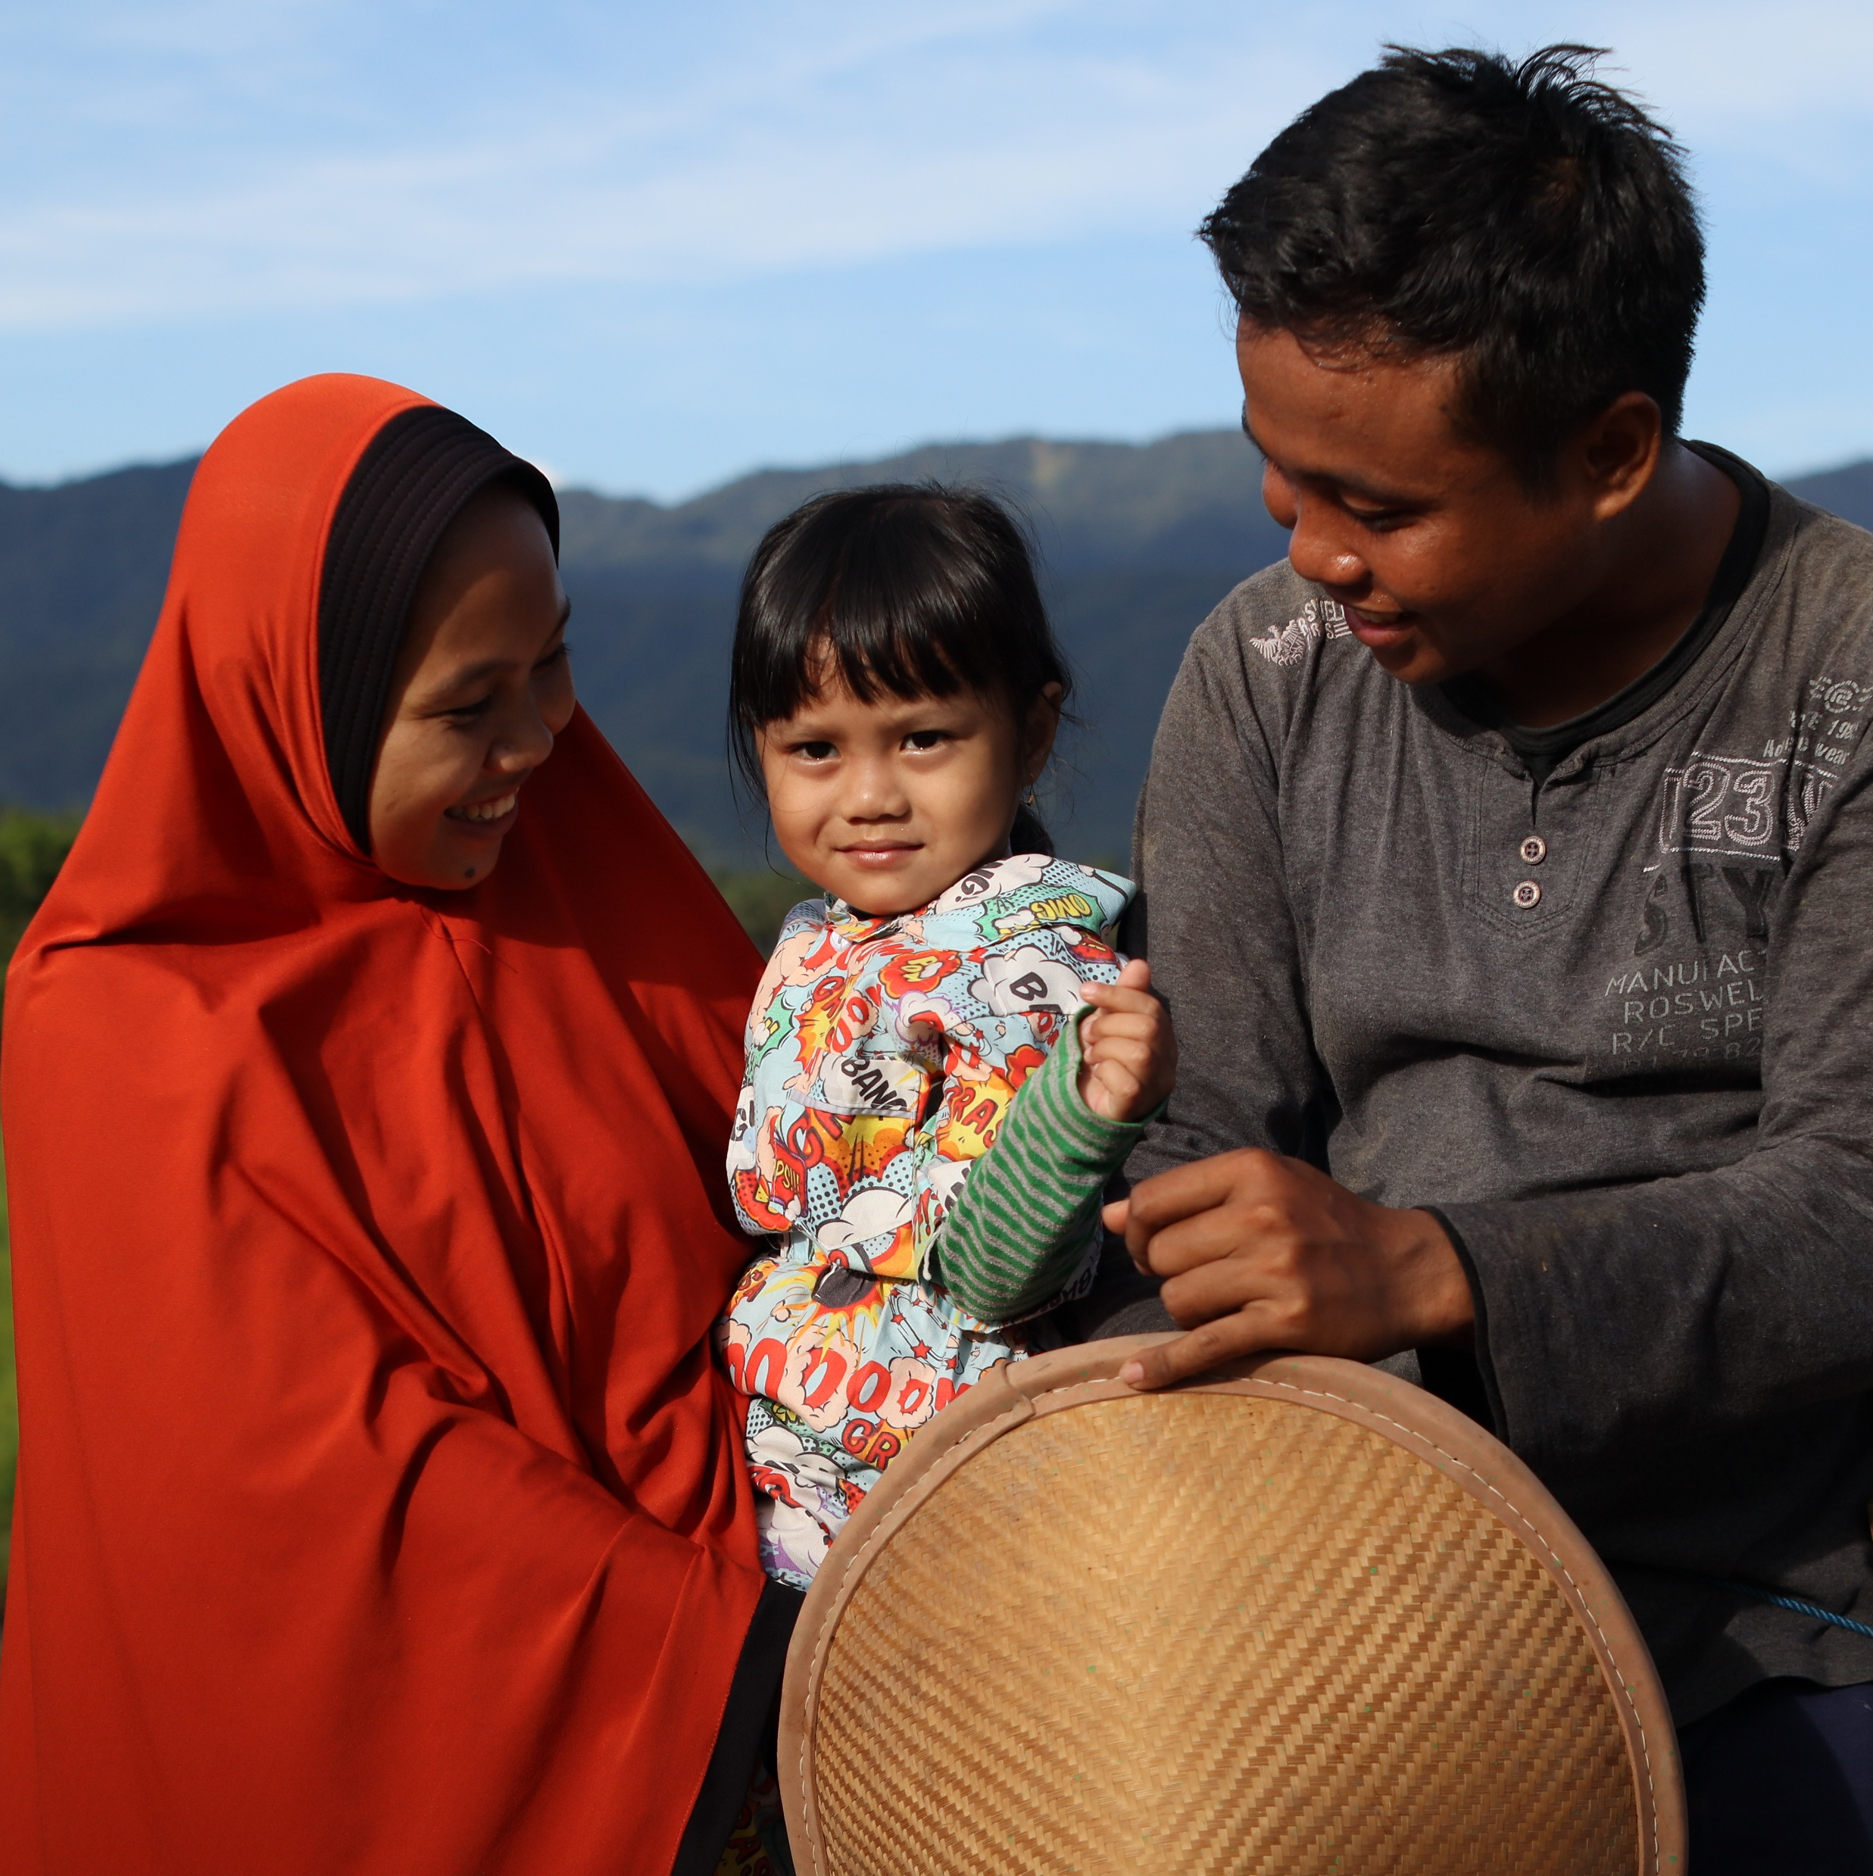
INDONESIA
Yayasan Cita Wadah Swaday (YCWSA) provides critical cash assistance programs for refugees in the Jakarta area and supports refugee children who have lost their families.
Funding cuts have halted this essential aid, leaving hundreds of people without financial support for food, housing, and basic needs, and children without shelter, food or education.
Indonesia. Agung Pranoto/Act for Peace
for humanKind
Notes:
In Indonesia, Act for Peace’s partner organisation Yayasan Cita Wadah Swaday (YCWS) has had so much of its funding cut that it has been forced to halt the cash assistance programs that refugees in Jakarta – including 70 unaccompanied refugee children – depend on for food and housing.
Dino Satria, Executive Director of YCWS, explains how desperate the situation is:
“Refugees cannot work, so the only thing that they can rely on is this assistance, and now they don’t receive any more cash.
“The most affected are vulnerable communities: women-headed households, mothers, and children.
"They are very anxious, very worried about their lives. They’ve already been worried about their future, staying here in Indonesia and trying to survive. Now, they are even more worried.”

Slide 6
PAKISTAN
Community World Service Asia provides essential healthcare, education, and community support services to more than 55,000 people in Pakistan.
Funding cuts have closed maternal and child healthcare services, leaving women and children highly vulnerable.
Cuts have also halted crucial programs supporting minority rights, women’s empowerment and education.
Pakistan. CWSA/Act for Peace
for humanKind
Notes:
In Pakistan, Act for Peace’s partner organisation, Community World Service Asia (CWSA) has lost 38 percent of its funding. As a result, they have suddenly been forced to close three offices and lose 32 staff members, impacting vital medical facilities including maternal and child healthcare services. The immediate danger is that infant and maternal mortality rates will increase sharply as women lose access to life-saving care.
Beyond that, public healthcare systems that rely on foreign aid face potential collapse, and vaccination campaigns and polio eradication efforts are at risk. Schools are at risk of closing, too, along with programs promoting girls’ education – and advances in rights for women and religious minorities are facing regression.
Shama Mall, Deputy Regional Director of CWSA, explains that her greatest fear is that funding cuts will have a lasting impact on health, education and social justice:
"It’s not just about providing services. It’s all the effort that organisations like us put in terms of social mobilisation, working with communities, getting their support, getting them to take leadership.
“When something like this happens, and everything stops abruptly, it affects the trust of communities in organisations like us."

Slide 7
PLEASE PRAY
For the wellbeing of the communities we support, who are devastatingly affected due to the loss of essential services and support.
For hope and resilience of the people affected, to fight in the face of adversity.
For our local partners, as they face uncertainty due to lack of funding for their projects and staff salaries.
For leaders around the world, that they grow compassion and empathy for people in need.
For our global community, that we can all come together and demand positive change for people in need around the world.
for humanKind
Notes:
Act for Peace’s global partners have requested us to join them in prayer for the following: [READ SLIDE]

Slide 8
act for peace today
SPEAK UP
Write to your MP promoting a Safer World For All
GIVE
Support our local partners to continue providing humanitarian programs through a financial gift
RAISE AWARENESS
Talk about it with your friends and family
for humanKind
Notes:
There are many ways we can support this appeal:
[READ SLIDE]

Slide 9
act for peace today
actforpeace.org.au/aid-hope
for humanKind
Notes:
To make a gift, or to learn more about how you can speak up and raise awareness, please
go to actforpeace.org.au/aid-hope
scan the QR code
call Act for Peace on 1800 025 101
or fill in the donation forms provided [PLEASE DOWNLOAD THE DONATION FORMS AND LET YOUR CONGREGATION KNOW WHERE TO FIND THEM]

